Slide 1
BEROWRA PS INSTRUCTIONAL ROUNDS TERM 2 2023

Slide 2
In Australia, mathematical systems have been developed over tens of thousands of years
Dr Tyson Yunkaporta, Senior Lecturer Indigenous Knowledges Deakin University

Slide 3
If you were a cartoon character, who would you be and why?

Slide 4
Learning Intentions
Through engagement with the research and discussion we are deepening your understanding of the worthwhile maths lesson in relation to Berowra’s PoP focus.

Slide 5
Success Criteria
Your collaboratively developed affinity maps will describe the most important elements and strategies you would expect to see if a maths lesson was worthwhile. You will:
Demonstrate connections you have made between the reading you have chosen and Berowra’s progress towards the worthwhile maths lesson.
Articulate effective strategies teachers can use to facilitate student to question, reason, communicate and share their mathematical understanding.
Identify strategies that develop productive discussion, deep student thinking and formatively assess.

Slide 6
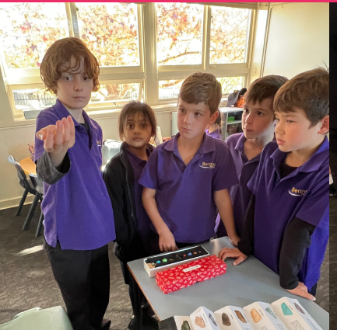
BEROWRA TEAM
BACKGROUND TO THE PROBLEM OF PRACTICE

Slide 7
Berowra’s Problem of Practice
Are our mathematics lessons worthwhile?
Are teachers using effective questions to deepen student thinking and formatively assess?
Are we providing opportunities for students to question, reason, communicate and share their mathematical understanding?

Slide 9
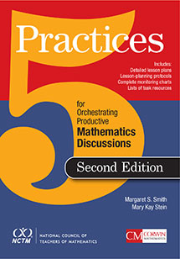
5 Practices for Orchestrating Productive Mathematics Discussions Smith, Hughes, Engle, Stein
GROUP JIGSAW ACTIVITY

Slide 10
Our teaching must be based on ongoing assessment

Slide 11
DYLAN WILIAM FORMATIVE ASSESSMENT Minute-by-Minute, Day-by -Day
If educators are serious about using assessment to improve instruction, then we need more fine-grained assessments, and we need to use the information to modify instruction as we teach.
Teachers need to pose effective questions and listen interpretively rather than evaluatively.
Teacher questions should prompt students to think and/or provide teachers with information so that they can adjust instruction to meet learning needs.

Slide 12
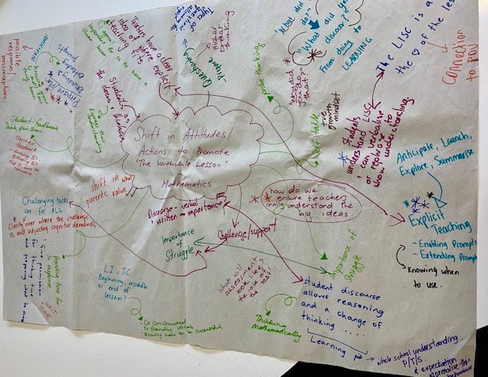

Slide 13
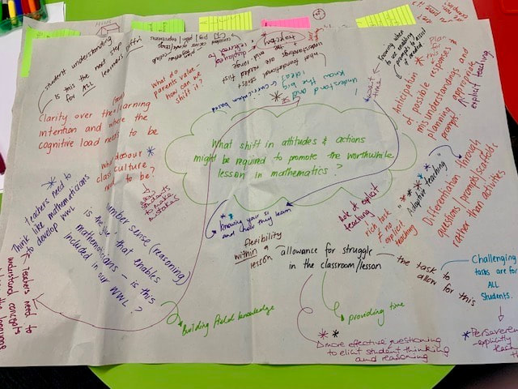

Slide 14
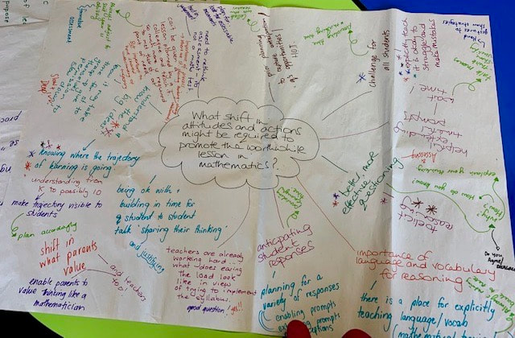

Slide 15
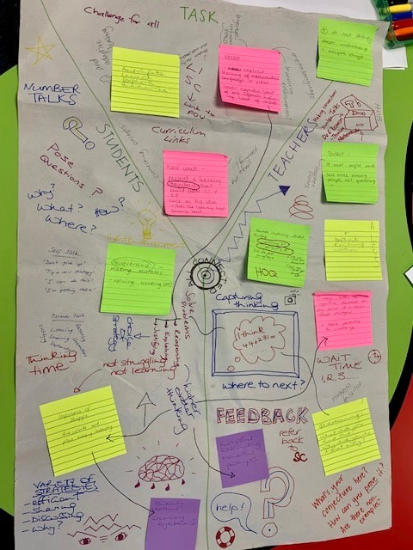

Slide 16
What question do you have for Berowra?
What reading/ idea/ resource did you think would be helpful?
What are its big key ideas?

Slide 17
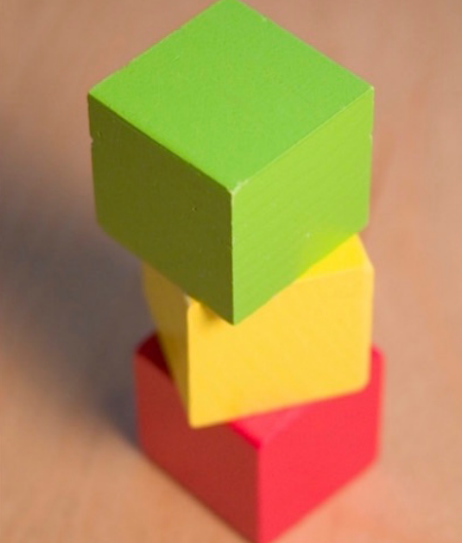

Slide 18
FRAMEWORK FOR ENGAGEMENT WITH MATHEMATICS Catherine Attard

Slide 19
Let’s get on the same page!
What is the difference between a student who is problem solving and
a student who is reasoning?

Slide 20
Students formulate and solve problems when they use:
use mathematics to represent unfamiliar or meaningful situations
design investigations
plan their approaches
apply their existing strategies to seek solutions
verify that their answer are reasonable.

Slide 21
Students are reasoning mathematically when they:
explain their thinking
deduce and justify strategies used and conclusions reached,
adapt the known to the unknown, transfer learning from one context to another
prove that something is true or false
compare and contrast related ideas
explain their choices.

Slide 22
Problem Solving and Reasoning
Problem Solving
Reasoning
Students develop the ability to
make choices
interpret
formulate
model and investigate problem situations
communicate solutions effectively
Students develop an increasingly
sophisticated capacity for logical thought and actions, such as:
analysing
evaluating
proving
explaining
Inferring
justifying
generalising

Slide 23
Key aspects of teaching reasoning
Reasoning should be an explicit part of each lesson.
Probing questions assist in promoting reasoning.
Allow wait time for reasoning to occur.
Reasoning is a social activity.
Notes:
Holton, D., Stacey, K., & FitzSimons, G. (2012). Reasoning: A Dog’s Tale. Australian Mathematics Teacher, 68(3), 22.

Slide 24
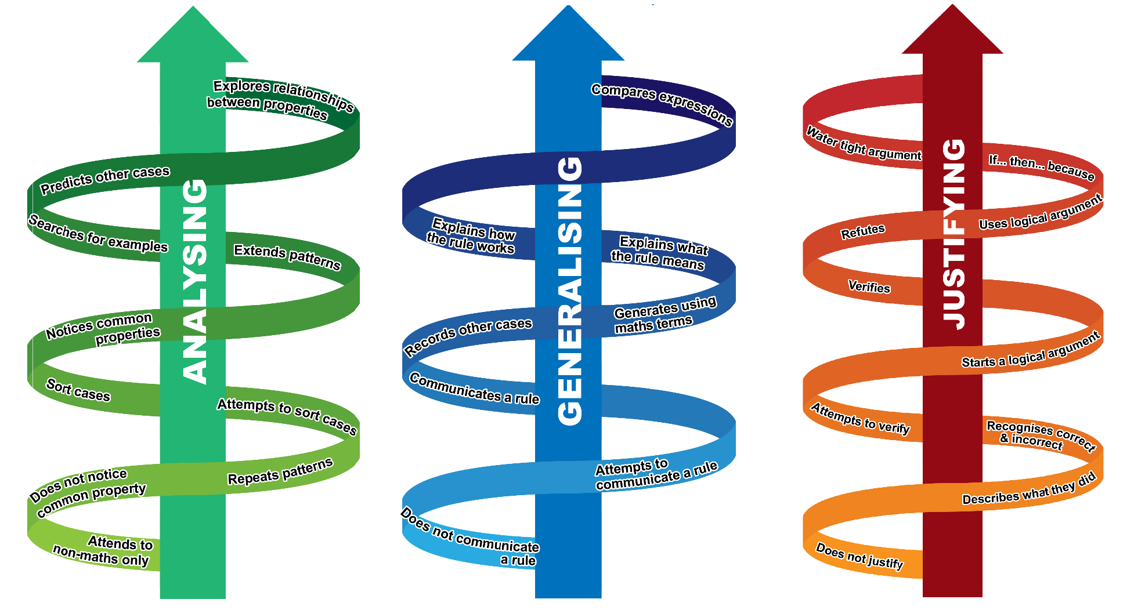
Reasoning Trajectories
Notes:
Three reasoning actions are emphasised for formative assessment: Analysing; Generalising; and Justifying.
Students’ reasoning may be captured orally, including through their gestures, and/or in their written work samples. This means teachers need to interact with students, listen to students as they work with others students or present to the whole class as well as analyse their written responses in order to assess students’ reasoning.
Reasoning should be embedded in all lessons. This might involve one or more of these reasoning actions.
These three trajectories indicate students’ progression through the three main reasoning actions.
As students’ develop their capacity to analyse they become more systematic and more often notice things that matter. The steps in this progression are summarised as: do not notice (common properties, patterns or relationships), recall and repeat, attempt to sort and order; sorts, classifies and orders, notices, describes; searches, predicts, explores relationships, notices relationships.
As student’ develop their capacity to form conjectures and generalise they communicate their conjectures and generalisations using more diverse & appropriate representations in accord with mathematics concepts. The steps in this progression are summarised as: does not communicate a conjecture or generalisation, makes a conjecture, extends (the conjecture to include more cases), communicates a rule, explains what (the rule means); identifies boundaries (for their rule); generalises properties and compares expressions (or rules and generalisations).
As students develop their capacity to justify and form logical arguments they communicate their arguments using more diverse & appropriate representations in accord with mathematics concepts. The steps in progress their developing capacity to justify and form logical arguments are: does not justify or appeals to authority (the teacher or other source), describes; checks the truth, detects and corrects (incorrect or untrue conjectures/generalisations); verifies or refutes conjectures/generalisations, starts a logical argument; completes the argument; or finally provides a water tight argument.
The steps in these reasoning learning trajectories are described more fully in the reasoning rubric.

Slide 25
Jo Boaler Mathematical Mindset (2016)
Research shows that question asking is linked to high achievement – yet as student move through the grades they ask fewer and fewer questions.

Slide 26
Peter Sullivan

Slide 27
If you truly wanted a maths lesson to be worthwhile?
What would you commit to do?
What would you resolve not to do?

Slide 28
WORTHWHILE LESSON
Tied to a Curricular Goal
Important lesson content
Meets the need of students

Slide 29
What do worthwhile lessons include?
Learning Target (Learning Intention)
Student Look Fors (Success Criteria)
Performance of Understanding (task)
PoU that both teaches and formatively assesses
Students do, make, say or write something that they clearly develops their understanding whilst giving evidence of it?
Feedback that feeds student learning forward
Student self-assessment
Effective questioning

Slide 30
PREPARING FOR OUR OBSERVATIONS Thinking: Observing closely and describing what’s there

Slide 31
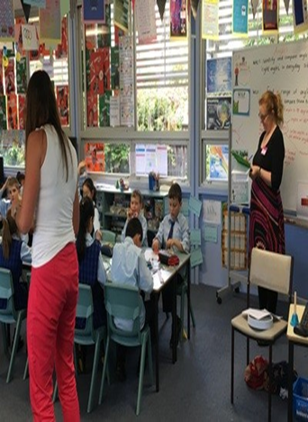
Protocols for classroom visits
The teacher does not stop to introduce you
Allow the teacher to continue without interruption
Observers don’t speak to each other
Observations are guided by the problem of practice
On departure we say thank you but make no other comment
We move away from the classroom before talking

Slide 32
Record
What the teacher is doing and saying
What the students are doing and saying
How students are interacting with the task

Slide 33
Over to the experienced!!!
What makes a good observations?

Slide 34
Observations
Slow down;
be in the moment.
Erase expectations.
Record what you see, not what you think about what you see.
Try to capture the conversation as close to verbatim as you can.
Remember that you cannot record everything that’s going on in the classroom. Just relax and write down what you can.

Slide 35
Learning to See: Learning to Unjudge
Learning to Listen
Unlearning to Tell & Show
Write what the students are:
Saying to each other
Writing in books and worksheets
Communicating mathematically – symbols, arrays
Write:
What are the Learning Intentions & Success Criteria
What is the teacher doing and saying? E.g., questions, feedback
What is the task? E.g., examples from the worksheet, word problem

Slide 36
S1. we put three magnets together. It still wouldn’t hold the gold nail ..even though we had three magnets it still wouldn’t stick
T. So he put three magnet-together ..maybe one magnet wasn’t strong enough.
Is that what he was thinking Gina?
S2. He was thinking to try each end. (demonstrates) something like that
T. What number comes next?
S1. 4
T. 4… think again. Who can help? xxx
S2 6
T. Yes great answer. Good work.

Slide 37
WHAT MADE YOU GO WOW!
detailed & specific
learning
teaching,
environment,
relationships,
routines,
scaffolds,
tasks

Slide 38
OBSERVATION DEBRIEFION DEBRIEF

Slide 39
LEARNING TO SEE: LEARNING TO UNJUDGE
Good observations stand alone
Good observations are representative of the lesson

Slide 40
LOOKING FOR PATTERNS IN THE DATA

Slide 41
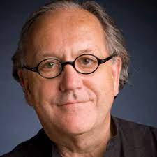
The number one challenge for most people is staying in the descriptive mode – this persists over time. Participants will be tempted to let a few non-evidentiary comments go unchecked. Resist the temptation. Once a few judgements slip into the conversation, they have the habit of reproducing like rabbits.

Slide 42
Predictions Answer the Question:
“If you were a student at this school and you did everything you were expected to do, what would you know and be able to do (in light of the patterns observed)?”

Slide 43
WHAT ONE CHANGE DOES THE GROUP BELIEVE MAY HAVE MADE THE LESSON MORE EFFECTIVE?

Slide 44
What are you thinking about after yesterday?

Slide 45
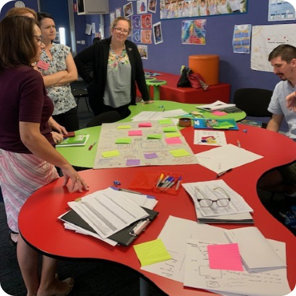
Explain how your thinking about maths teaching and learning is
different today from yesterday,
and from what it could be tomorrow?

Slide 46
BEROWA’S SITUATION

Slide 47
NETWORK PROPOSES THE NEXT LEVEL OF WORK
Considering all the evidence we have collected and analysed related to Berowra’s PoP
How can they focus their energy and resources to make progress on the problem of practice?
What (new) knowledge and skills might teachers need, and how might the school support that learning?

Slide 48
NETWORK PROPOSES THE NEXT LEVEL OF WORK
A collection of powerful questions and starting ideas to help the school move forward
AND remain focused on improving student learning and outcomes.

Slide 49
EXAMPLES OF POWERFUL QUESTIONS FROM A RECENT ROUND
How do we ensure professional learning translates into sustained change of classroom practice?
Do teachers and students understand the purpose of the SC and how this is used to give feedback to allow students to be self-directed learners?
How can we take the whole school community on the journey towards rigorous learning?
How active are our students in their learning? How do we know?
Are our assumptions about our students and parents preventing us from taking important initiatives? How could we explore this?

Slide 50
How do you ensure all teachers are using low floor, high ceiling challenging mathematical tasks that allow rich classroom discussions and create the expectation that students will explain what they have done and their underlying thinking?
Develop teacher agreement on What challenge and rigor look like in mathematics and why is this important?
Investigate the place and design of “low floor – high ceiling” tasks (See reSolve Professional Learning Module) Gather data about the level of challenge currently occurring through student interview, rounds, Check Ins. etc.
Look at examples on the Universal Hub Website - review the scope and sequence to incorporate high level extensions, collaborative plans based on our top kids.

Slide 51
How can we ensure the concepts from our professional learning are embedded, sustained and used as the starting point for the next round of professional learning?
Some exemplary practices are starting to emerge in the teaching of mathematics. If you move on too quickly these will not be sustained & you will lose them. Plan to continue your focus on mathematics for at least two more terms.
Members of the school leadership team discuss what is essential for professional learning to be embedded. Use the document by Timperley, “Teacher Professional Learning & Development” https://www.creatingrounds.com/leading-change.html

Slide 52
Next Rounds
Week 7 Term 3
Wednesday 25 and
Thursday 26 October
Thornleigh West PS

Slide 53
What is the instructional core?

