Slide 1
CONNECT COLLABORATE GROW INSTRUCTIONAL ROUNDS NETWORK
TTHORNLEIGH WEST PS 2019

Slide 2
INTRODUCTION TO THORNLEIGH WEST’S PROBLEM OF PRACTICE

Slide 3
PROBLEM OF PRACTICE
How well do the qualities of the tasks deepen thinking and learning?
Does the task:
challenge students to move beyond their current level of understanding, and skill in the reasoning of the discipline?
encourage students to generate and articulate original ideas, explanations, solutions, responses or findings?
promote students' understanding of big ideas? and
ensure deep understanding and thinking?

Slide 4
EACH ROUND FOLLOWS A SET FORMAT
1. Host school identifies a problem of practice
2. Network explores best practice in that aspect of teaching
3. Observation in classrooms and description without judgement
4. Observational debrief
5. Network proposes next level of work
Notes:
With those big ideas underpinning it, then Instructional Rounds follows a process.

Slide 5
Sixth Principle
We learn to do the work by doing the work, not by telling other people to do the work, not by having done the work at some time in the past, and not by hiring experts who can act as proxies for our knowledge about how to do the work.

Slide 6
Our knowledge of instruction builds over time
In IR we build a common language of instructional practice. Our knowledge and understanding builds over time.
Within and between schools we build a culture of inquiring and learning at a deep level.
As a network we support leaders and teachers develop their practice by focusing attention on the knowledge and skill needed for both teaching and leading.

Slide 7
TODAY’S LEARNING/ LEARNING CHALLENGE
“We’ve got to think it through, get into the complexity & really work together”
This Photo by Unknown Author is licensed under CC BY-ND

Slide 8
PLANNING WITH THE END IN MIND
You will gain a deep understanding of the qualities of a “worthwhile lesson” and a “performance of understanding”; be able to apply this understanding to create worthwhile lessons and tasks across KLAs; and be able to support and guide others to do the same.

Slide 9
WHY IS THIS IMPORTANT?
What did you say?

Slide 10
LEARNING TRAJECTORY
Giving feedback and planning to support others
Applying understanding to create a worthwhile lesson
Performance of understanding
Ensuring challenge
Learning target with students in mind
Three-legged stool of worthwhile lesson
Important curricular goal – essential question

Slide 11
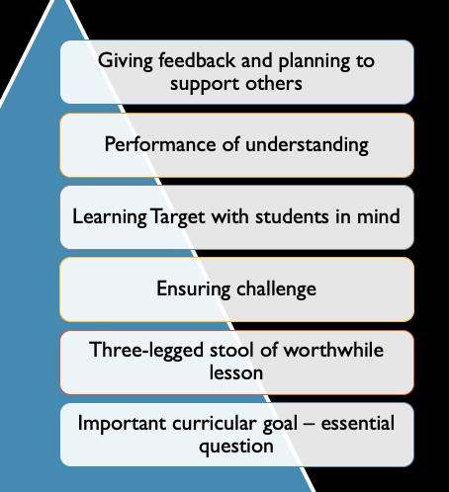
IMPORTANT CURRICULAR CONTENT “ESSENTIAL QUESTIONS”
WHAT DID YOU SAY?
WHAT DID YOU ASK?
Notes:
READ COMMENTS FROM I USED TO THINK & TWO QUESTIONS

Slide 12
THE IMPORTANCE OF ESSENTIAL UNDERSTANDING
Think of it like a garden trellis, your subject gives you structure while you grow. Without the trellis you’re just groundcover, sprawling out in all directions, no matter how good the soil is or how much love your parents pour in.
Alan Finkel, Australia’s Chief Scientist
Reasoning skills of the discipline
Content - conceptual understanding

Slide 13
IMPORTANT CURRICULAR CONTENT NSW CURRICULUM REVIEW
The current curriculum arrangements are not the arrangements that will best serve children and young people of NSW in the future.
The crowded nature of the curriculum, including the amount of content that some syllabuses expect teachers to cover, is not conducive to teaching in depth or helping students see the relevance of what they are learning.
The lock-step nature of the curriculum, including the specification of what should be taught, when it should be taught, and how long should be spent teaching it, does not provide the flexibility teachers require to ensure every student is appropriately challenged and making excellent progress (preface v)

Slide 14
IMPORTANT CURRICULAR CONTENT
This Interim Report proposes general design concepts for a possible future curriculum. The Review envisages syllabuses that are:
leaner in content and more focused on developing deep understandings of disciplinary concepts and principles;
a curriculum structure that better recognises and accommodates the wide variability in students’ levels of attainment;
the closer integration of theory and application and an increased focus on building students’ skills in applying knowledge. (preface, v)

Slide 15
IMPORTANT CURRICULAR CONTENT
This review sees learning with understanding as a central goal of every school subject. As students make progress in a subject, they not only acquire more sophisticated knowledge and higher levels of skill, they also develop deeper understandings of the concepts and principles at the heart of the subject. These concepts and principles enable students to structure and make sense of the material they are learning and are a crucial aspect of increasing competence.
Learning for understanding can be contrasted with the superficial memorisation of facts and procedures. Although no curriculum intends to promote superficial learning, this can be the outcome when curricula specify large amounts of material to be learnt, focus on the performance of specific tasks, or are based on checklists of outcomes or skills.
When a curriculum attempts broad ‘coverage’ of a subject, there is often pressure to address many topics in a short space of time, resulting in an emphasis on memorisation and the learning of disconnected information. Such curricula are sometimes referred to as ‘mile wide and inch deep’. Learning for understanding is further compromised when assessment processes prioritise the testing of facts and skills over assessments of thinking and understanding (p62).

Slide 16
WORTHWHILE LESSON THREE-LEGGED STOOL

Slide 17
THE THREE SOURCES
1. National/state standards and curriculum goals
2. Important concepts and/or skills for the specific lesson
3. The specific needs of students
WHAT DID YOU SAY?
Notes:
READ FROM I USED TO THINK

Slide 18
QUOTES
1.Today’s lesson and each lesson that precedes or follows it should have a “reason to live”. | 2. Teacher keeps his focus, “Five years from now what would I want the student to remember from this lesson?”
3. Designing a lesson focusing on what students learn will differ significantly from designing lessons around what students do and complete. | 4. Whilst many skills require more than one day’s practice, what makes a lesson not worthwhile is repeating the same practice for the same reasons.

Slide 19
FROM OUR LAST ROUND:
PERFORMANCE OF UNDERSTANDING
You will collaboratively develop a lesson to meet the requirements of the three sources as stated in the “Collaborative Inquiry Guide for a Worthwhile Lesson”.
You will apply your knowledge of the three sources when giving feedback to another group’s lesson plan; and when categorising your classroom observations during the round debrief.
Think about the lesson sequence
Focus on one lesson
Add a brief summary of what students’ learnt before & what they will learn next?

Slide 20
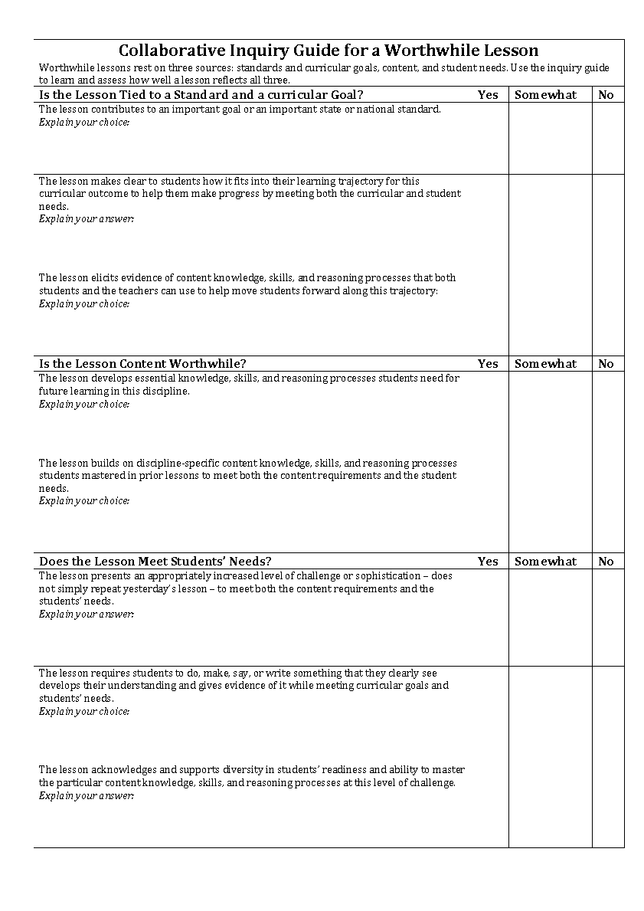

Slide 21
DEVELOPING YOUR LESSONS
First Step
Explain your lesson to new members in your group
5 minutes only
Geography Places Similar and Different | English: Multimodal text Dust Echoes – Whirlpool Story
History: First Contact Essential question: What impact occurs when cultures collide? | Maths Essential question: What is multiplication?

Slide 22
LEARNING INTENTION & SUCCESS CRITERIA
Learning Intention
You will deepen your understanding of Learning Intentions & Success Criteria and be able to apply this to lessons across KLAs
Success Criteria
Your Learning Intention and Success Criteria will meet the requirements of the Four Column Learning Target Framework

Slide 23
LEARNING TARGET/ INTENTIONS/ SUCCESS CRITERIA
MINI –LESSON 1
At what point do you consider the learning target when planning?

Slide 24
CONSIDER THE WHOLE LEARNING TARGET
S.M. Brookhart & C. M. Moss, 2014

Slide 25
FOCUS: LEARNING TARGET
What will I be able to do at the end of today’s lesson?
What do I have to learn to be able to do it?
How will I be asked to show that I can do it?
How well will I be expected to do it?
Notes:
STEPHY – ADD OR CHANGE SLIDE AS YOU LIKE,

Slide 26
THE FOUR-COLUMN LEARNING TARGET FRAMEWORK FOR LESSON PLANNING
S.M. Brookhart & C. M. Moss, 2019

Slide 27
ADD OR REFINE THE LEARNING TARGET FOR YOUR LESSON
Geography Places Similar and Different | English: Multimodal text Dust Echoes – Whirlpool Story
History: First Contact Essential question: What impact occurs when cultures collide? | Maths Essential question: What is multiplication?
Notes:
STEPHY TO KEAD – ADD OR CHANGE SLIDE AS YOU LIKE

Slide 28
FOCUS: CHALLENGE
“Our schools are committed to ensuring that every student is engaged in meaningful, challenging and future-focused learning.
Our aim is to inspire and support teachers to try new practices, and to promote dialogue and collaboration across our network schools.”

Slide 29
PROBLEM OF PRACTICE
How well do the qualities of the tasks deepen thinking and learning?
Does the task:
challenge students to move beyond their current level of understanding, and skill in the reasoning of the discipline?
encourage students to generate and articulate original ideas, explanations, solutions, responses or findings?
promote students' understanding of big ideas? and
ensure deep understanding and thinking?

Slide 30
LEARNING INTENTION
You will deepen your understanding of some main ideas for the concept of learning challenge, and the strategies that teachers could use to ensure this.
You will be able to apply this understanding when developing lessons across KLAs.

Slide 31
SUCCESS CRITERIA
Your annotated diagram of the Learning Pit will incorporate the the main ideas and teaching strategies shown in the video.
Your lesson will meet the collaboratively developed success criteria for a lesson that “challenges students to move beyond their current level of understanding”.

Slide 32
PERFORMANCE OF UNDERSTANDING
You will collaborate with others in your group to annotate or illustrate the diagram of the Learning Pit with the main ideas and suggested teaching strategies from the video.
You will reflect on your lesson plan to gauge the level of challenge and modify it as required.

Slide 33
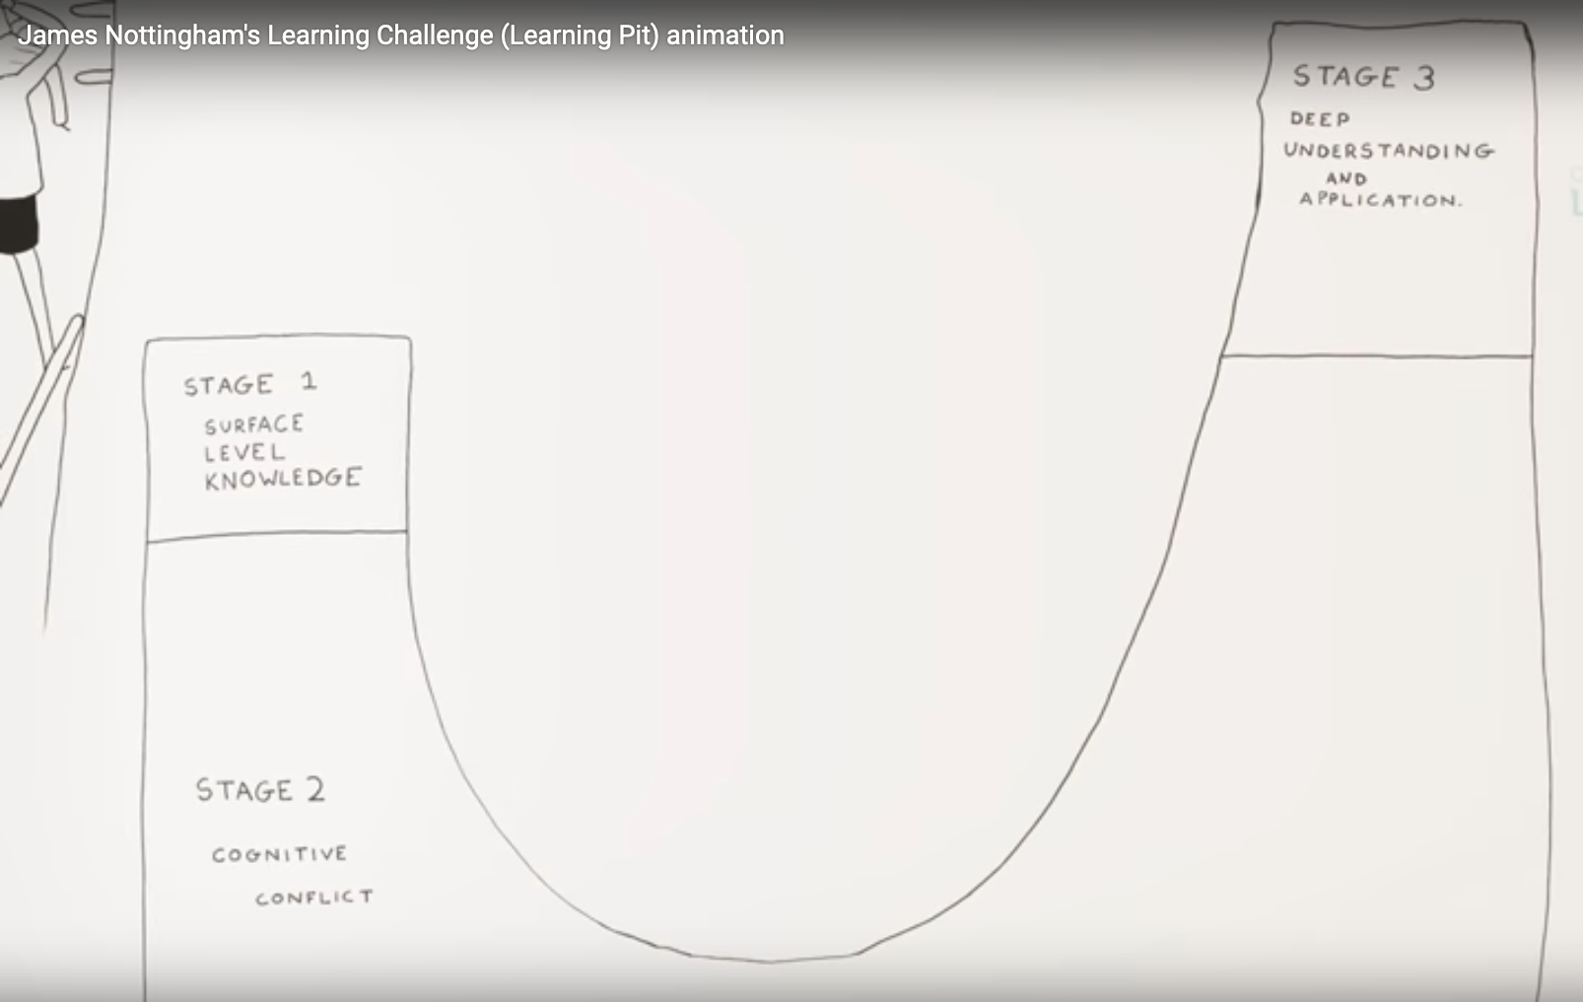
Collaborate with others in your group to annotate and/or illustrate this diagram with the main ideas and suggested teaching strategies from the video.

Slide 34
REFLECT & MODIFY YOUR LESSONS TO ENSURE CHALLENGE
SUCCESS CRITERIA
How will you know if you’ve been successful?
Collaboratively develop Success Criteria

Slide 35
FOCUS: PERFORMANCE OF UNDERSTANDING
A performance of understanding - what students do, say, make, or write to learn during the lesson - engages students directly with intended knowledge, skills and reasoning and in the process shows students what each of these mean. It deepens students’ understanding and provides strong evidence of what they know and can do.

Slide 36
LEARNING TARGET
You will deepen your understanding of the essential qualities of a “performance of understanding.”
You will be able to apply this understanding when developing lessons across the Key Learning Areas.

Slide 37
SUCCESS CRITERIA
Your collaboratively developed Chalk Talk will show connections you’ve made from the text to a range of personal beliefs, other texts, and school and classroom practices.
Group discussions using Final Word Protocol will highlight the main ideas underpinning a performance of understanding and possible misunderstandings.
Your performance of understanding for your collaboratively developed lesson will meet all the criteria in the Collaborative Inquiry Guide

Slide 38
How will we cater for individual differences?
Activities to identify and draw on your background knowledge;
Opportunities to ask questions;
Participation in robust conversations.

Slide 39
CHALK TALK
Share the connections you made from the reading: the last round, your experience, other theories or practices.

Slide 40
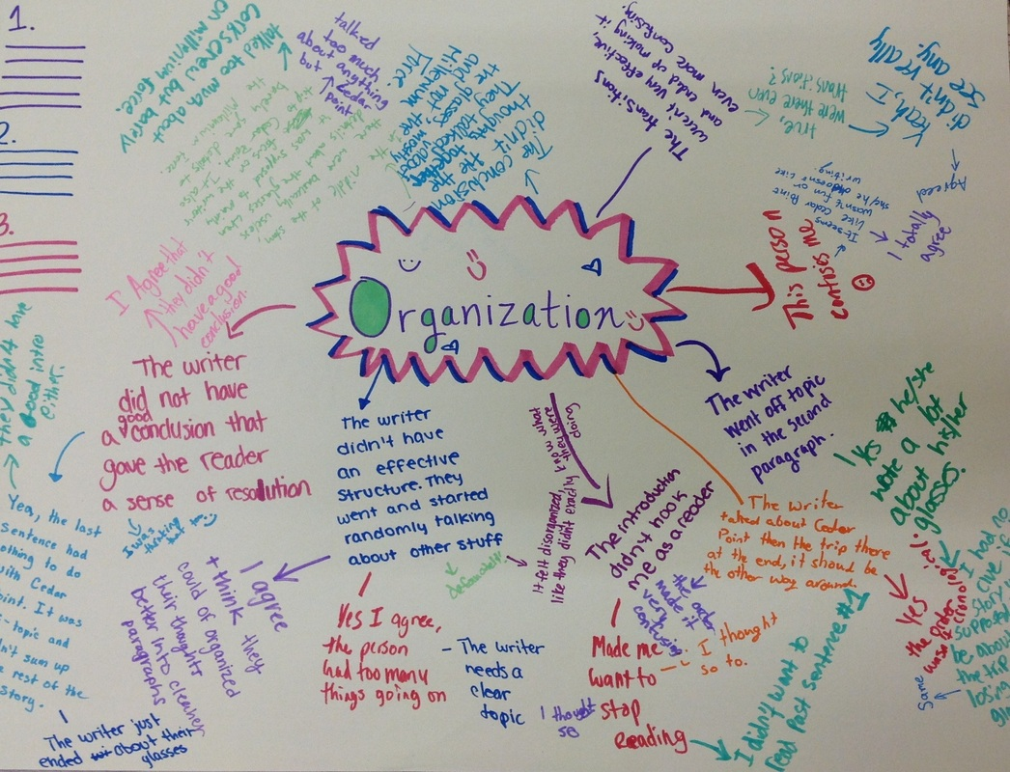
CHALK TALK
What connections did you make with the text?
with your beliefs
with other texts or theories
with other teaching/ learning/ leadership practices
eg Rounds - “the most critical source of evidence is what students are learning”

Slide 41
Final Word protocol for shared clarity
1.One person shares one item they have highlighted. Read aloud only what it says and makes no comment.
2.Each person in turn makes one comment in round-robin order. No cross talk
3.When each person has commented on the item, the person who nominated it summarises the group thinking and shares his/her thinking about the item, thus getting the final word.
4.Repeat.
I think that’s important because …..
A question that raises for me is …..
Building on that idea, I think….
That connects with what I’ve experienced when ………..

Slide 42
Performance of Understanding
Add a performance of understanding to your collaboratively developed lesson.
Be sure that the performance of understanding meets all the criteria from our Collaborative Inquiry Guide.

Slide 43
DATA
“Give me any data from your school and I’ll tell you five different stories about it. Just tell me which ones you want to hear.”
Don’t be data driven. Be driven to find the data that actually matters.
Changing our practice hinges on changing our lens.”
- Jeff Duncan Andrade

Slide 44
DATA THAT MATTERS
“Raising student achievement doesn’t happen one test at a time, whether that test is standardized or teacher made. Test results are always an incomplete picture of what’s happening in a classroom. Yet we continue to tweak instructional methods to raise test scores so that we can build and marvel at data sets that allow us to claim ”data-driven decision making”.
It is a logic model that ignores the most critical source of evidence – what students are actually learning. Gathering information about that learning should be everyone’s role, and turning that data into evidence by using it to improve student learning should be everyone’s most important work”.
Connie Moss and Susan Brookhart, Formative Classroom Walkthroughs, p99

Slide 45
Underpinned by Beliefs
What determines what students know and are able to do is not what the curriculum says they are supposed to do, or even what the teacher thinks he or she is asking the students to do. What predicts performance is what students are actually doing.
If you can’t see it in the instructional core, it’s not there!
Notes:
More big ideas.

Slide 46
MAKING RECOMMENDATIONS

