Slide 1
TASK:
Create a resource to present to our network that applies your understanding of the readings to one KLA of your choice.
If you were presenting to the teachers of Oakhill Drive;
What are the key messages you would give them
What are the strategies would you suggest they try in your selected KLA as their first few steps in implementing this problem of practice.

Slide 2
Dural IR Network ODPS - 27th & 28th July 2017
Donna Harris, Claire Eiffert, Liesl Stevens and Rob Ernstiens

Slide 3
Feels Like
Can be chaotic and busy
Natural flow
Student guided
Teacher driving focus
Every student valued
Concrete materials
Looks Like
Wait time
Listening, hearing and responding
Constructive
Peer building
Inclusive
Substantive Communication
in Mathematics
Sounds Like
Loud
Questioning
Talk time
Lots of process and mathematical talk
Working Mathematically
Genuine interest in students ideas and contributions

Slide 4
Substantive Communication in Mathematics
What I would expect to see;
Loud classroom atmosphere
Teacher vacating the floor → Dialogic Practice
Students leading the discussion
Teacher uses guided questions to maintain the focus
Student engaged
Teacher modelling effective and responsive listening
Working Mathematically → Process talk
How do we get there?

Slide 5
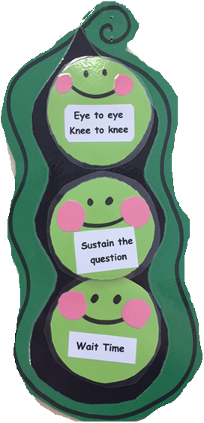
Strategies
Focus question from teacher to drive conversation
Questions not statements
Model how to listen and respond; “Am I really listening?” “Are my questions responsive?” “Are we sustaining the question?”
Stimulus to reinforce or scaffold to direct the communication; - RUCSAC - Eye to eye, knee to knee - Think, pair, share

Slide 6
Teach them how to TALK | Teach them how to LISTEN
Question Formulation Technique: Robust tool for promoting greater student engagement and deeper learning Think alouds from teacher Model how to effectively ask questions Sentence starters | Model responsive answers Questions that follow student talk Contingent Scaffolding relies on a teacher identifying a teachable moment, using talk in the form of questions and answers to maximise learning potential Question Formulation Technique: Am I truly listening and can I add on to that?
GOOD questions and ACTIVE listening

Slide 7
Readiness VS Responsiveness
Teacher readiness - Focus question - Sentence starters - WALT/WILT - Teachers goals
Teacher responsiveness - Real time - Immediate - Natural flow - Student needs
Intent Trumps Form: WHY we ask a question in more important than HOW we ask it

