Slide 1
Rich Problem Solving Tasks
Prepared by Sefton Infants School

Slide 2
Rich Problem Solving Task Evaluator
Is it a problem or is it a problem solving task?
START

Slide 3
Is it a problem or a problem solving task?
PROBLEM | PROBLEM SOLVING
Practising a technique Memorising procedures Memorising formulas Doing exercises | Engaging with real problems by guessing, discovering & making sense of mathematics Seeking solutions Exploring patterns Formulating conjectures An investigative approach
A problem is only a problem if you don’t know what to do.
Real problem solving tasks are those that the children haven’t seen before and need to work out what to do. They don’t necessarily have to be ‘real world’ problems.

Slide 4
Rich Problem Solving Task Evaluator
Is it a problem OR is it a problem solving task?
Is the problem solving task open-ended OR fixed?
START

Slide 5
Is the problem solving task open-ended or fixed?
Task allows for a range of different approaches, different responses and different representations.
Task draws on knowledge, procedures and strategies from a wide variety of mathematical topics.
Task caters for a variety of thinking styles and promotes higher order thinking.

Slide 6
Rich Problem Solving Task Evaluator
1. Is it a problem OR is it a problem solving task?
2. Is the problem solving task open-ended OR fixed?
3. Does the problem solving task have ‘productive failure?
START

Slide 7
Does the problem solving task have ‘productive failure’?
Challenge, persistence and self-regulation are required in the task.
Premise that allowing the learners to struggle helps them to construct deeper meaning and understanding.
Students who are not given teacher prompting but allowed to collaborate outperform scaffolded students when tested on what they have learned. They are also able to transfer knowledge more effectively.

Slide 8
Does the problem solving task have ‘productive failure’?
Intentionally managing the way learners ‘productively fail’:
Challenge but do not frustrate.
Provide opportunities for students to explain and elaborate on what they are doing.
Give learners a chance to compare and contrast strategies and solutions to the problem solving task.

Slide 9
Rich Problem Solving Task Evaluator
1. Is it a problem OR is it a problem solving task?
2. Is the problem solving task open-ended OR fixed?
3. Does the problem solving task have ‘productive failure’?
START
4. Does the task involve the cycle of problem solving?

Slide 10
Does the task involve the cycle of problem solving?
Represent
Analyse
Interpret & Evaluate
Communicate & Reflect

Slide 11
Does the task involve the cycle of problem solving?
Task requires application of problem solving steps and strategies.
Task combines fluency and mathematical reasoning.
Students make meaningful connections with prior mathematical experiences and knowledge including strategies and procedures.
Students pose questions, as well as share mathematical ideas by challenging and justifying mathematical thinking and reasoning.

Slide 12
Rich Problem Solving Task Evaluator
1. Is it a problem OR is it a problem solving task?
2. Is the problem solving task open-ended OR fixed?
3. Does the problem solving task have ‘productive failure’?
START
5. Is formative assessment of the problem solving strategies used embedded in the task?
4. Does the task involve the cycle of problem solving?

Slide 13
Is formative assessment of the strategies used embedded in the task?
When assessing problem solving, a greater weighting should be given to the strategies used than to the solution.
Strategies and processes in learning intentions and success criteria.
Understanding and application of the strategy / strategies both need to be gauged.

Slide 14
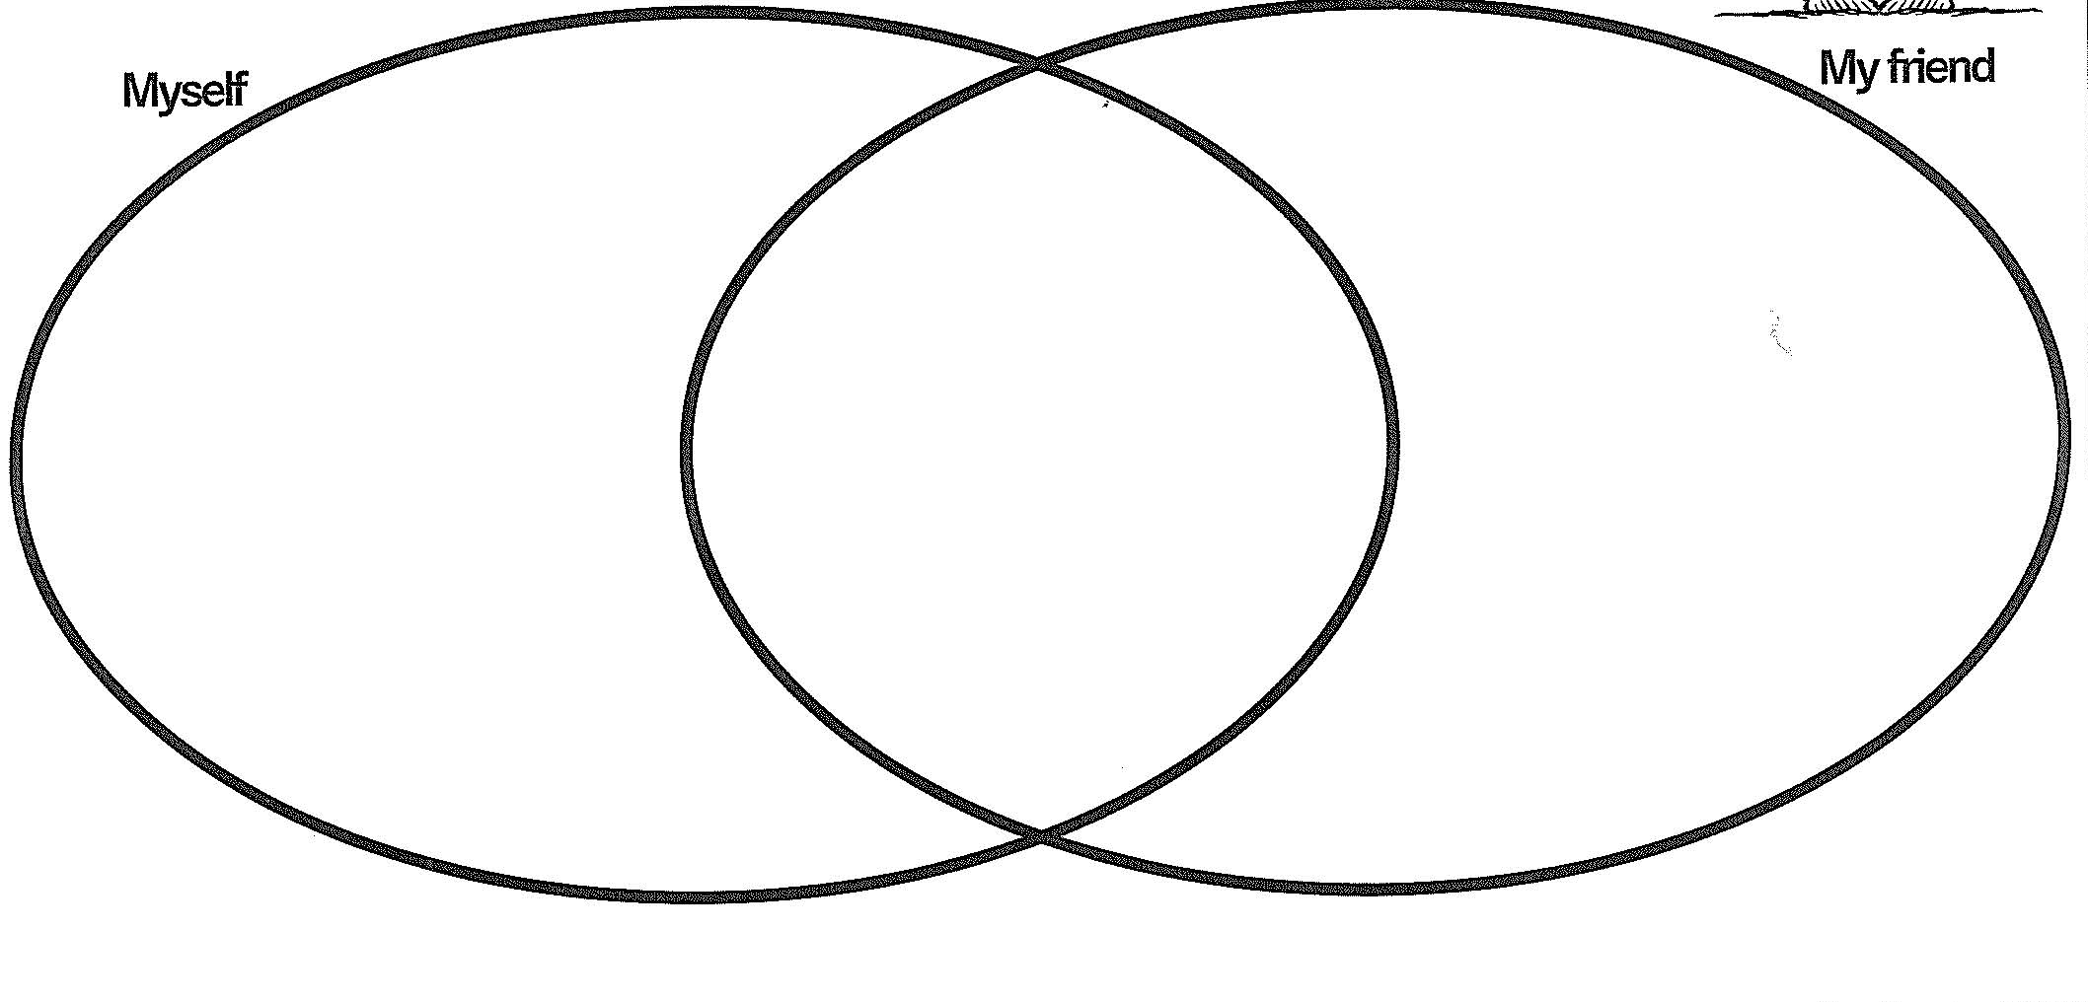
Is formative assessment of the strategies used embedded in the task?
For example:
Venn with a Friend
Think about the what you did to solve your problem / play your game. Compare your strategies and reflections with a friend.

Slide 15
Rich Problem Solving Task Evaluator
1. Is it a problem OR is it a problem solving task?
2. Is the problem solving task open-ended OR fixed?
3. Does the problem solving task have ‘productive failure’?
START
5. Is formative assessment of the problem solving strategies used embedded in the task?
4. Does the task involve the cycle of problem solving?
Rich
Task ?
a X

